Slide 1

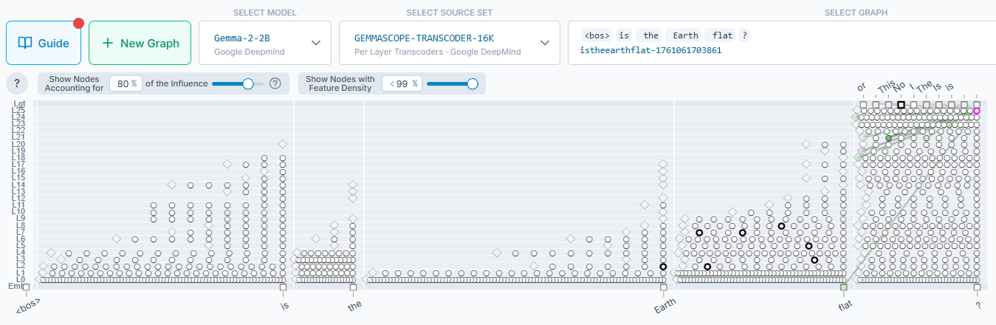
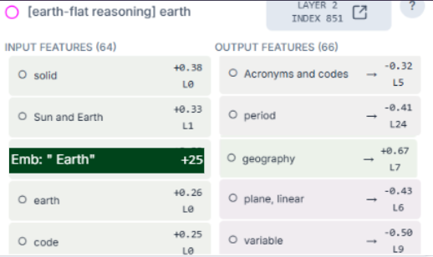
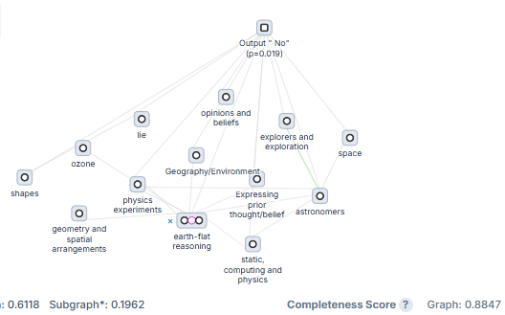
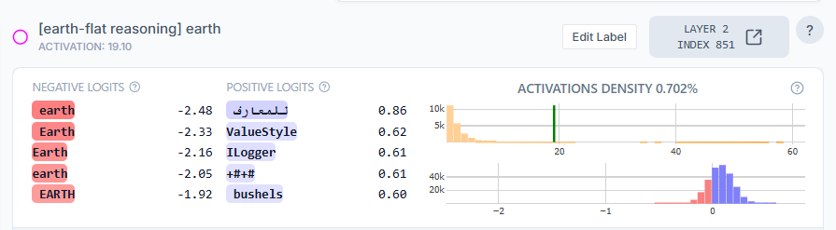
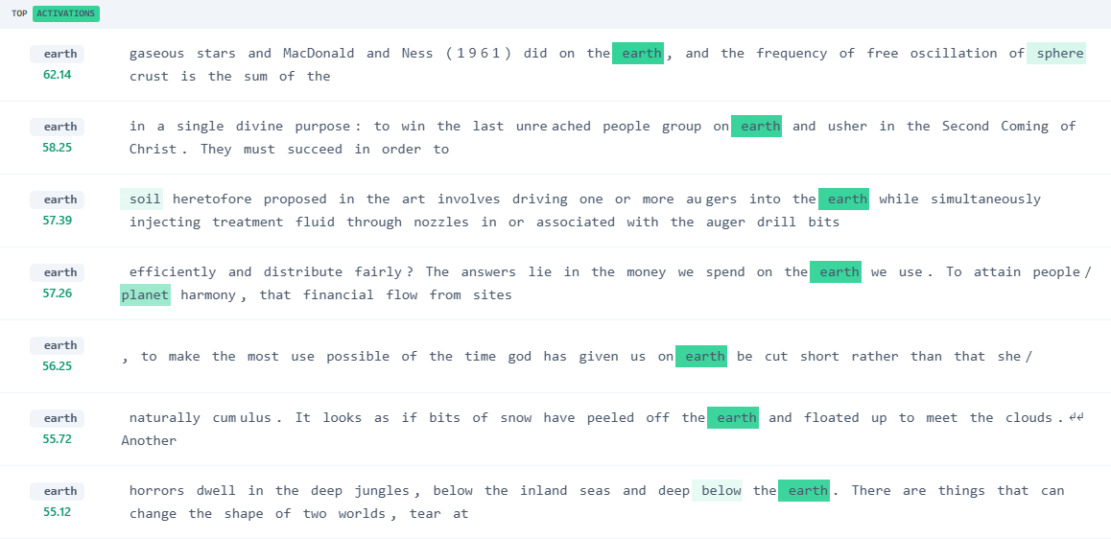
HOW AI MODELS REASON: THE ‘EARTH–FLAT’ CIRCUIT ANALYSIS

Slide 2
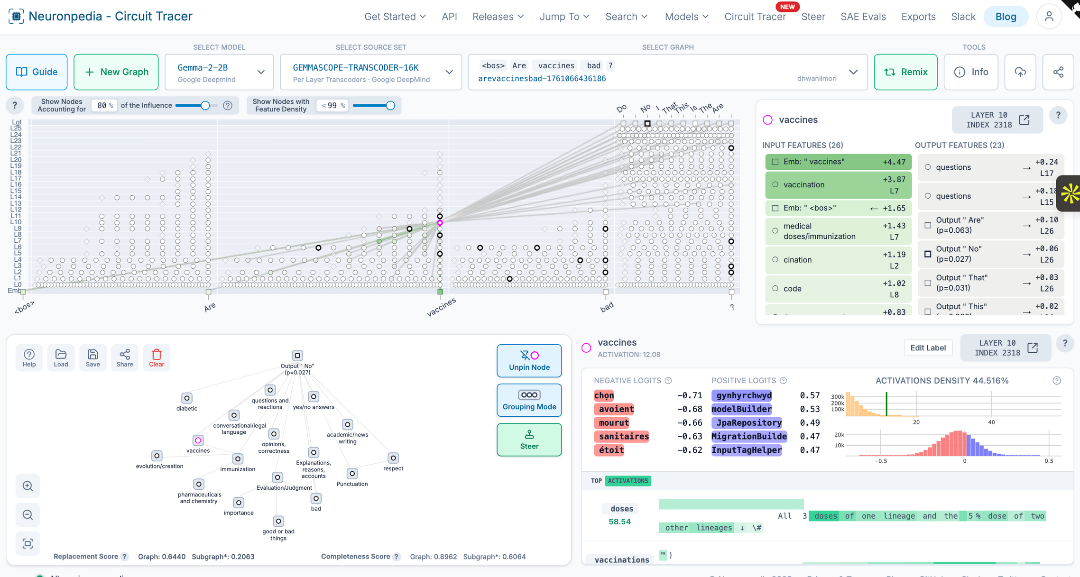
HOW AI MODELS REASON: VACCINES-BAD?’ CIRCUIT ANALYSIS

